Slide 1
SUMMARY
TOPSI 2.0 -
The future of SOK Stores and Chains applications
Capgemini
21st August 2015

Slide 2
SUMMARY
Solution approach
Continuous deployment pipeline
One cross-functional team
Roadmap principles
Analyst voice and references

Slide 3
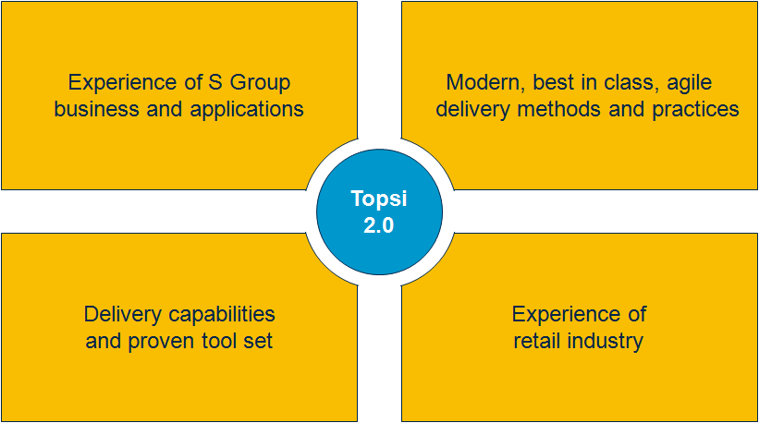
We have prepared this solution based on our proven delivery capabilities and experience of S Group business
SUMMARY
Our approach and solution is built on:
Our wide experience of S Group Chains and Stores business and applications
Understanding of SATO targets and vision
Our deep understanding of modern, best in class, agile application development, application management and application operations delivery methods and practices
Our delivery capabilities and proven tool set
Our experiences of retail industry and similar services in several industries

Slide 4
Our solution integrates development, operations, testing and infrastructure into one agile, end-to-end pipeline
SUMMARY
Required TOPSI 2.0 Application Lifecycle Elements:
Business
Development
Testing
Operations
Agile Development – Continuous Integration –
Continuous Delivery – Automated Testing & Security –
Application Performance Management & Monitoring –
Delivery Orchestration – Scalable Infrastructure

Slide 5
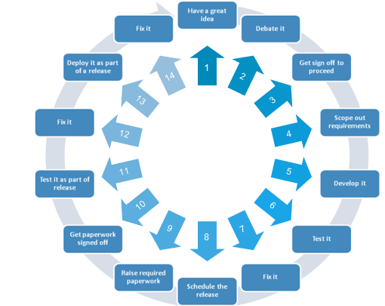
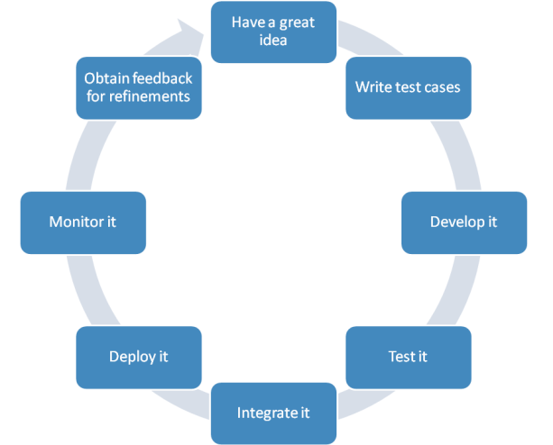
The objective is to simplify and streamline the application lifecycle management from development to operations
SUMMARY
1
2
3
4
5
6
7
8

Slide 6
Today waste is generated in many areas but it can be removed radically
SUMMARY
Current ways of working
Manual Work Deployments require human intervention and actions We must rely on release and environment specific installation instructions and scripts Environment configuration is done on an “as-needed” basis
Long Wait Times Throughout The Pipeline Teams waiting on manual handoffs Delayed time-to-test Insufficient notification
Unproductive Work and Inefficient Use of Environments Deploying things that have not changed Deploying same things several times in many environments Using static environments, not leveraging virtualization & cloud Managing infrastructure & apps separately
Poor Visibility Outside the Silos Reliance on release notes, spreadsheets, distribution lists, and high number of status meetings and calls Limited understanding of deployment dependencies and status Long or too many outage windows
Required changes
Removing Activities Requiring Manual Work Automated deployments Graphical process designer Environment configuration managed as part of deployment (scalable infrastructure)
Eliminating Long Wait Time Bottlenecks Automated notifications Include provisioning as part of deployment Add automated testing to deployment process
Reducing Root Causes of Unproductive Work Only deploy what has changed Leverage production-like environments e.g. in testing Get the most out of virtualization & cloud Manage infrastructure & applications together
Raising Visibility by Removing the Silos and Setting Up One Team Known status of resources at-a-glance Immediate view of deployment compliance Status, feedback & understanding of all parts of deployment as it occurs

Slide 7
The savings can be achieved: Capgemini has implemented DevOps into an application landscape of 50 applications
SUMMARY
Before
Deployment of solution: 6h
Creating a new environment (e.g. for testing): 4 weeks
Application availability: < 99,4%
Knowledge restricted to one critical resource
Static documentation
After
Deployment of solution: 2h
Creating a new environment: 6 hours
Application availability: >99,6%
Knowledge spread among team
Dynamic, everything including documentation “as code”
Situation
January 2014
20 FTE in Operations team
44 Applications
Deployments in production • 38 manual applications • 6 automated applications
13 FTE in Infrastructure team
15+ manual processes
0 automated processes
December 2014
16 FTE in Operations team
50 Applications
Deployments in production • 27 manual applications • 23 automated applications
10 FTE in Infrastructure team
8+ manual processes
7 automated processes
-20% in AO
labor cost
+14% more applications
46% of deployments automated
Results
-13% in infra
labor cost
46% of
processes automated
Source: Capgemini service in Europe

Slide 8
Our solution brings several benefits in terms of improved quality…
SUMMARY
Benefits
Improved Quality
Easy and faster access to new features and business functionalities: capability to meet the constantly changing business requirements
Higher end-to-end availability and successful days at business processes due to:
Less disruptive upgrades
Less hand-overs within release deployments
Automated provisioning
Automated testing
Automated deployments
Better change management in the whole environment
Improved security.
Flexibility and Agility
Lower Lifecycle Costs

Slide 9
… increased flexibility and agility throughout the pipeline…
SUMMARY
Benefits
Faster time-to-market of solutions that meet changing business needs due to:
Built-in flexibility when moving from Waterfall IT to Agile IT
Acceptance of changes in smaller, granular and manageable portions
Shorter development-to-production lifecycle
Increased automation level in
Continuous integration
Testing
Continuous deployment
Infrastructure provisioning
Improved capability to cope with changes in application landscape and support introduction of new technologies:
Our agile pipeline model supports SATO transitions
Our model is not applicable only to current application landscape but can also be applied to SATO
Improved Quality
Flexibility and Agility
Lower Lifecycle Costs

Slide 10
…and remarkable overall cost savings
SUMMARY
Benefits
Improved Quality
Significantly lower development costs due to
Simplified and agile sw-development process (e.g. case Fosteri)
Efficient use of offshore also in development
Less manual work in all phases due to increased automation
Lower infrastructure costs due to dynamic, scalable capacity and resource scaling
Lower license costs due to use of SaaS and Open Source Software tools
Less effort spent on wasteful deliveries due to stable and predictable releases.
Flexibility and Agility
Lower Lifecycle Costs

Slide 11
SUMMARY
Solution approach
Continuous deployment pipeline
One cross-functional team
Roadmap principles
Analyst voice and references

Slide 12


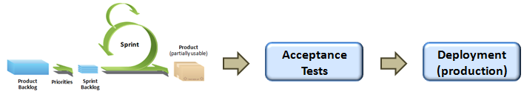

We will create one continuous deployment pipeline
SUMMARY
Now
570 deployments in 2014!
Development
Release pack
Testing
Operations
Release pack
Release pack
Release pack
Continuous deployment pipeline
Testing
Operations

Slide 13

Capgemini’s integrated solution optimizes the time-to-market and enables constant flow of value
SUMMARY
Delivery Orchestration
Agile Development
Continuous Integration
Continuous Delivery
Dynamic Capacity
Automated Testing
DEV
Application Performance Monitoring
TEST
Business
Optimized cycle time
PROD
Continuous Feedback Loop

Slide 14
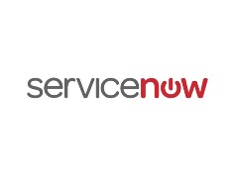
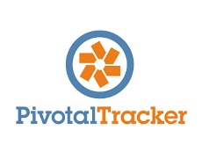
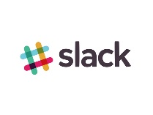
Agile Development
Purpose
Agile development is an effective development model without communication silos, ability to react to changing business needs and enable short lead time for features.
Agile development promotes adaptive planning, evolutionary development, early delivery, continuous improvement, and encourages rapid and flexible response to change.
Key activities
Share a vision of the result
Plan roadmap, release schedule and prioritize features
Revisit often to ensure ability to react to possible business changes
Build solution, release early and often
Learn and optimize the process
Practices include daily- and weekly meeting for maximum visibility and co-operation.
Capgemini choice of tools:

Slide 15
Agile Development
Purpose
Agile development is an effective development model without communication silos, ability to react to changing business needs and enable short lead time for features.
Agile development promotes adaptive planning, evolutionary development, early delivery, continuous improvement, and encourages rapid and flexible response to change.
Improved Quality
Capgemini choice of tools
Capgemini choice of tools
Key activities
Share a vision of the result
Plan roadmap, release schedule and prioritize features
Revisit often to ensure ability to react to possible business changes
Build solution, release early and often
Learn and optimize the process
Practices include daily- and weekly meeting for maximum visibility and co-operation.
Flexibility and Agility
Key activities
Share a vision of the result
Plan roadmap, release schedule and prioritize features
Revisit often to ensure ability to react to possible business changes
Build solution, release early and often
Learn and optimize the process
Practices include daily- and weekly meeting for maximum visibility and co-operation.
Lower Lifecycle Costs
Capgemini choice of tools:
Purpose
Agile development is an effective development model without communication silos, ability to react to changing business needs and enable short lead time for features.
Agile development promotes adaptive planning, evolutionary development, early delivery, continuous improvement, and encourages rapid and flexible response to change.
Purpose
Agile development is an effective development model without communication silos, ability to react to changing business needs and enable short lead time for features.
Agile development promotes adaptive planning, evolutionary development, early delivery, continuous improvement, and encourages rapid and flexible response to change.

Slide 16
Agile Development
Capgemini choice of tools
Key activities
Share a vision of the result
Plan roadmap, release schedule and prioritize features
Revisit often to ensure ability to react to possible business changes
Build solution, release early and often
Learn and optimize the process
Practices include daily- and weekly meeting for maximum visibility and co-operation.
Improved Quality
Capgemini choice of tools
Key activities
Share a vision of the result
Plan roadmap, release schedule and prioritize features
Revisit often to ensure ability to react to possible business changes
Build solution, release early and often
Learn and optimize the process
Practices include daily- and weekly meeting for maximum visibility and co-operation.
Flexibility and Agility
Lower Lifecycle Costs
Purpose
Capgemini choice of tools:
Agile development is an effective development model without communication silos, ability to react to changing business needs and enable short lead time for features.
Agile development promotes adaptive planning, evolutionary development, early delivery, continuous improvement, and encourages rapid and flexible response to change.
Purpose
Agile development is an effective development model without communication silos, ability to react to changing business needs and enable short lead time for features.
Agile development promotes adaptive planning, evolutionary development, early delivery, continuous improvement, and encourages rapid and flexible response to change.
Purpose
Agile development is an effective development model without communication silos, ability to react to changing business needs and enable short lead time for features.
Agile development promotes adaptive planning, evolutionary development, early delivery, continuous improvement, and encourages rapid and flexible response to change.

Slide 17
Agile Development
Purpose
Agile development is an effective development model without communication silos, ability to react to changing business needs and enable short lead time for features.
Agile development promotes adaptive planning, evolutionary development, early delivery, continuous improvement, and encourages rapid and flexible response to change.
Key activities
Share a vision of the result
Plan roadmap, release schedule and prioritize features
Revisit often to ensure ability to react to possible business changes
Build solution, release early and often
Learn and optimize the process
Practices include daily- and weekly meeting for maximum visibility and co-operation.
Capgemini choice of tools:

Slide 18
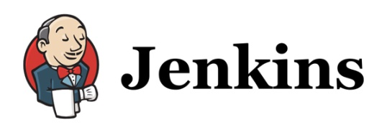
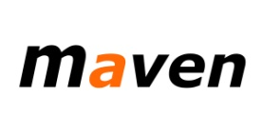
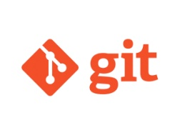


Continuous Integration
Purpose
Continuous Integration (CI) is a development practice with purpose of to surface any problems or inconsistency in code development immediately, so it can be fixed immediately. In other words ensure the quality early in the process.
Key activities
Developers integrate code into a shared repository several times a day. The code is automatically build and validated. The code that does not meet criteria cannot be committed further.
Static code analysis and unit tests are run (automatically) to ensure quality
Build binaries (war, ear) for deployments on to the Application Servers including packaging the different modules/applications
Capgemini choice of tools:

Slide 19
Continuous Integration
Capgemini choice of tools
Key activities
Developers integrate code into a shared repository several times a day. The code is automatically build and validated. The code that does not meet criteria cannot be committed further.
Static code analysis and unit tests are run (automatically) to ensure quality
Build binaries (war, ear) for deployments on to the Application Servers including packaging the different modules/applications
Improved Quality
Capgemini choice of tools
Key activities
Share a vision of the result
Plan roadmap, release schedule and prioritize features
Revisit often to ensure ability to react to possible business changes
Build solution, release early and often
Learn and optimize the process
Practices include daily- and weekly meeting for maximum visibility and co-operation.
Flexibility and Agility
Lower Lifecycle Costs
Purpose
Capgemini choice of tools:
Continuous Integration (CI) is a development practice with purpose of to surface any problems or inconsistency in code development immediately, so it can be fixed immediately. In other words ensure the quality early in the process.
Purpose
Agile development is an effective development model without communication silos, ability to react to changing business needs and enable short lead time for features.
Agile development promotes adaptive planning, evolutionary development, early delivery, continuous improvement, and encourages rapid and flexible response to change.
Purpose
Agile development is an effective development model without communication silos, ability to react to changing business needs and enable short lead time for features.
Agile development promotes adaptive planning, evolutionary development, early delivery, continuous improvement, and encourages rapid and flexible response to change.

Slide 20

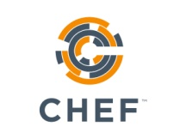
Continuous Delivery
Purpose
Continuous Delivery (CD) automates and improves the process of software delivery. It provides the ability to rapidly, reliably and repeatedly push out enhancements and bug fixes to customers at low risk and with minimal manual overhead.
Key activities
Manage, plan and control the storage and flow of binaries and configurations used for deployments relying on the software release cycles.
Capgemini choice of tools:

Slide 21
Continuous Delivery
Capgemini choice of tools
Key activities
Manage, plan and control the storage and flow of binaries and configurations used for deployments relying on the software release cycles.
Improved Quality
Capgemini choice of tools
Key activities
Share a vision of the result
Plan roadmap, release schedule and prioritize features
Revisit often to ensure ability to react to possible business changes
Build solution, release early and often
Learn and optimize the process
Practices include daily- and weekly meeting for maximum visibility and co-operation.
Flexibility and Agility
Lower Lifecycle Costs
Purpose
Capgemini choice of tools:
Continuous Delivery (CD) automates and improves the process of software delivery. It provides the ability to rapidly, reliably and repeatedly push out enhancements and bug fixes to customers at low risk and with minimal manual overhead.
Purpose
Agile development is an effective development model without communication silos, ability to react to changing business needs and enable short lead time for features.
Agile development promotes adaptive planning, evolutionary development, early delivery, continuous improvement, and encourages rapid and flexible response to change.
Purpose
Agile development is an effective development model without communication silos, ability to react to changing business needs and enable short lead time for features.
Agile development promotes adaptive planning, evolutionary development, early delivery, continuous improvement, and encourages rapid and flexible response to change.

Slide 22

Automated Testing
Purpose
Test automation helps to ensure application quality and cost effectiveness of testing (early error detection, regression testing)
Enable agile feature releases with fast test cycle time.
Key activities
Test environments and automation setup
Test case creation to automation suite
Capture and test of behavior, data and performance characteristics of complete application environments
Tests are build and executed continuously throughout development
Capgemini choice of tools:
Capgemini Automation Framework Café
X-Tester
QTP utilities
Robot Framework

Slide 23
Automated Testing
Capgemini choice of tools
Key activities
Test environments and automation setup
Test case creation to automation suite
Capture and test of behavior, data and performance characteristics of complete application environments
Tests are build and executed continuously throughout development
Capgemini Automation Framework Café
Robot Framework
Improved Quality
Capgemini choice of tools:
Capgemini Automation Framework Café
X-Tester
QTP utilities
Robot Framework
Key activities
Share a vision of the result
Plan roadmap, release schedule and prioritize features
Revisit often to ensure ability to react to possible business changes
Build solution, release early and often
Learn and optimize the process
Practices include daily- and weekly meeting for maximum visibility and co-operation.
Flexibility and Agility
QTP utilities
X-Tester
Lower Lifecycle Costs
Purpose
Capgemini choice of tools:
Test automation helps to ensure application quality and cost effectiveness of testing (early error detection, regression testing)
Enable agile feature releases with fast test cycle time.
Purpose
Agile development is an effective development model without communication silos, ability to react to changing business needs and enable short lead time for features.
Agile development promotes adaptive planning, evolutionary development, early delivery, continuous improvement, and encourages rapid and flexible response to change.
Purpose
Agile development is an effective development model without communication silos, ability to react to changing business needs and enable short lead time for features.
Agile development promotes adaptive planning, evolutionary development, early delivery, continuous improvement, and encourages rapid and flexible response to change.

Slide 24

Service Virtualization
Purpose
Virtualization is to provide environments (like Dev, QA, Integration, Testing, UAT, Pre-prod, Prod etc) for the applications to be deployed and tested
Key activities
Assessment of the application landscape for virtualization potential
Define virtualization strategy for various Testing Processes
Virtualization Business case definition and ROI calculation
Rollout virtualization services
Evolve Applications and virtualization adoption services across lifecycle
Capgemini choice of tools:
Automation Assessment Toolkit
VServe

Slide 25
Service Virtualization
Capgemini choice of tools
Key activities
VServe
Assessment of the application landscape for virtualization potential
Define virtualization strategy for various Testing Processes
Virtualization Business case definition and ROI calculation
Rollout virtualization services
Evolve Applications and virtualization adoption services across lifecycle
Improved Quality
Capgemini choice of tools:
Automation Assessment Toolkit
VServe
Key activities
Share a vision of the result
Plan roadmap, release schedule and prioritize features
Revisit often to ensure ability to react to possible business changes
Build solution, release early and often
Learn and optimize the process
Practices include daily- and weekly meeting for maximum visibility and co-operation.
Flexibility and Agility
Automation Assessment Toolkit
Lower Lifecycle Costs
Purpose
Capgemini choice of tools:
Virtualization is to provide environments (like Dev, QA, Integration, Testing, UAT, Pre-prod, Prod etc) for the applications to be deployed and tested
Purpose
Agile development is an effective development model without communication silos, ability to react to changing business needs and enable short lead time for features.
Agile development promotes adaptive planning, evolutionary development, early delivery, continuous improvement, and encourages rapid and flexible response to change.
Purpose
Agile development is an effective development model without communication silos, ability to react to changing business needs and enable short lead time for features.
Agile development promotes adaptive planning, evolutionary development, early delivery, continuous improvement, and encourages rapid and flexible response to change.

Slide 26
Dynamic Infrastructure Capacity
Purpose
Dynamic infrastructure enables agile and automated infrastructure management and provisioning of development, test and production environments. It lowers costs with pay-as-you-go model and increases quality, reliability and visibility of infrastructure.
Key features
Dynamic Capacity with horizontal & vertical scalability:
Vertical - scaling a single node (CPU/Memory/Disk)
Horizontal - scaling the amount of nodes; best fit for distributed and stateless cloud-ready applications
Automated provisioning via self service portal, e.g:
Service requests: launch a VM, modify and terminate
Control VMs: start, stop, restart and hibernate
Fast, versatile and standard delivery:
On-demand, pre-established infrastructure
Immediate value creation
Elimination of foundation tasks
Exceptionally high security standards:
System residues in high-secure infrastructure
Two-phased strong authentication for all users of Cloud portal
All processes related to infrastructure comply with our high security (governmental) customer processes
Infrastructure as a Code
Capgemini choice of tools:
Capgemini Nordic Cloud

Slide 27
Dynamic Infrastructure Capacity
Capgemini choice of tools
VServe
Key activities
Improved Quality
Capgemini choice of tools:
Automation Assessment Toolkit
VServe
Dynamic Capacity with horizontal & vertical scalability:
Vertical - scaling a single node (CPU/Memory/Disk)
Horizontal - scaling the amount of nodes; best fit for distributed and stateless cloud-ready applications
Automated provisioning via self service portal, e.g:
Service requests: launch a VM, modify and terminate
Control VMs: start, stop, restart and hibernate
Fast, versatile and standard delivery:
On-demand, pre-established infrastructure
Immediate value creation
Elimination of foundation tasks
Exceptionally high security standards:
System residues in high-secure infrastructure
Two-phased strong authentication for all users of Cloud portal
All processes related to infrastructure comply with our high security (governmental) customer processes
Infrastructure as a Code
Key activities
Share a vision of the result
Plan roadmap, release schedule and prioritize features
Revisit often to ensure ability to react to possible business changes
Build solution, release early and often
Learn and optimize the process
Practices include daily- and weekly meeting for maximum visibility and co-operation.
Flexibility and Agility
Automation Assessment Toolkit
Lower Lifecycle Costs
Purpose
Capgemini choice of tools:
Dynamic infrastructure enables agile and automated infrastructure management and provisioning of development, test and production environments. It lowers costs with pay-as-you-go model and increases quality, reliability and visibility of infrastructure.
Purpose
Agile development is an effective development model without communication silos, ability to react to changing business needs and enable short lead time for features.
Agile development promotes adaptive planning, evolutionary development, early delivery, continuous improvement, and encourages rapid and flexible response to change.
Purpose
Agile development is an effective development model without communication silos, ability to react to changing business needs and enable short lead time for features.
Agile development promotes adaptive planning, evolutionary development, early delivery, continuous improvement, and encourages rapid and flexible response to change.

Slide 28
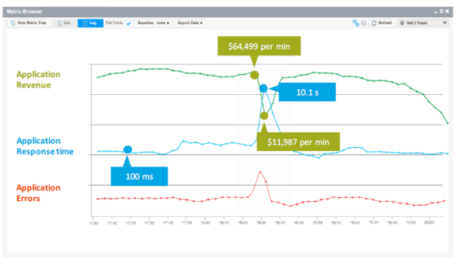
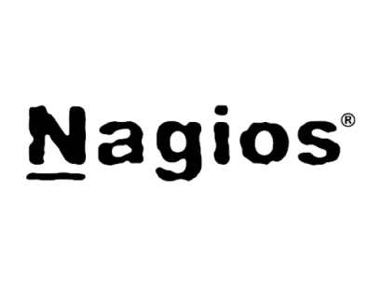

Application Performance Management (APM)
Purpose
Goal for Application Performance Management (APM) is to ensure availability and optimal performance of applications. This is accomplished by monitoring problems, early warning signs (e.g. trends) of issues and user behaviour.
Key features
Utilize the feedback loop for application technical performance and user behavior for optimization and development
APM tools alert IT staff to disruptions in availability and/or quality
Monitor the IT stack from infrastructure to applications
Detect security breaches, Plan & budget for IT upgrades
Automatically collects normal metrics for normal application performance and compares those to the current state in real time
AppDynamics for APM
Nagios for some specific monitoring needs
Logstash for log analysis
Capgemini choice of tools:

Slide 29
Application Performance Management (APM)
Key activities
Capgemini choice of tools
Utilize the feedback loop for application technical performance and user behavior for optimization and development
APM tools alert IT staff to disruptions in availability and/or quality
Monitor the IT stack from infrastructure to applications
Detect security breaches, Plan & budget for IT upgrades
Automatically collects normal metrics for normal application performance and compares those to the current state in real time
Improved Quality
AppDynamics for APM
Nagios for some specific monitoring needs
Logstash for log analysis
Key activities
Share a vision of the result
Plan roadmap, release schedule and prioritize features
Revisit often to ensure ability to react to possible business changes
Build solution, release early and often
Learn and optimize the process
Practices include daily- and weekly meeting for maximum visibility and co-operation.
Flexibility and Agility
Lower Lifecycle Costs
Capgemini choice of tools:
Purpose
Goal for Application Performance Management (APM) is to ensure availability and optimal performance of applications. This is accomplished by monitoring problems, early warning signs (e.g. trends) of issues and user behaviour.
Purpose
Agile development is an effective development model without communication silos, ability to react to changing business needs and enable short lead time for features.
Agile development promotes adaptive planning, evolutionary development, early delivery, continuous improvement, and encourages rapid and flexible response to change.
Purpose
Agile development is an effective development model without communication silos, ability to react to changing business needs and enable short lead time for features.
Agile development promotes adaptive planning, evolutionary development, early delivery, continuous improvement, and encourages rapid and flexible response to change.

Slide 30

Example of an APM dashboard with Business and IT KPI’s

Slide 31

Delivery Orchestration
Purpose
The purpose of the delivery orchestration is to manage the application life cycle across teams and environments end to end from the requirement identification to the ongoing production support including application, infra and tools.
Delivery orchestration uses automated tool, which automatically remediate the majority of event alerts on a daily basis for IT operations. Based upon the type of alert, the orchestration environment automatically takes the steps necessary to identify and diagnose the problem.
Key activities
Managing the lifecycle of changes:
Ensuring that changes are monitored, tracked and controlled from initial logging through to the production environment,
Ensuring that all Changes are authorized by the required Change Authorizers
Ensuring that changes are prioritized by the Client and managing back log
Liaising, throughout the life cycle of a change, with Support Groups, Third Party Suppliers and Client
Coordinating Change handlers and ensuring that agreed changes are delivered on-time and on agreed scope.
Maintaining release plan and coordinating deployments and releases
Runs daily stand-up meetings and weekly operation meetings.
Coordinating production support for application (monitoring and resolution)
Routine tasks and ad hoc activities
Configuration management
Project management
Continuous improvement of processes and procedures based on requirements from SOK, incidents and defects, other feedback
Capgemini choice of tools:
Virtual Visual Management Confluence

Slide 32
SUMMARY
Solution approach
Continuous deployment pipeline
One cross-functional team
Roadmap principles
Analyst voice and references

Slide 33
One cross-functional team is responsible for the application product end-to-end
SUMMARY
Features
One team across borders despite the location or organization
Traditional silos are destroyed and everybody has access to same dashboards and tools
Multi-skilled teams enable efficient work flow
Instead of each team focusing separately either on coding, testing or deploying everybody focuses on the product itself and strives for common goal
Benefits
New approach improves efficiency and knowledge sharing
It tightly integrates business, development and operations to drive agility and delivery excellence across the entire lifecycle
Notes:
siloed teams, each with differing motivations and areas of focus doesn’t deliver consistency.
Common goals, tools and processes
Team is empowered to self-sufficient as they can code, test and deploy

Slide 34
Certain roles are vital for successful implementation of agile methods throughout application lifecycle
SUMMARY
Release Manager oversees coordination and integration of development, testing and deployment tasks to support continuous delivery
Automation Architect analyzes, designs, and implements automation strategies
Experience Assurance Professional ensures that all new features and functions are released with intended end user experience
Product Owner is responsible for the product success and value creation
Technical specialists takes care of both development and operational tasks and testing
Service Delivery Manager is
contact point for contractual terms
Orchestration Lead
coordinates all work from development to production and has end to end responsibility for ensuring continuous flow of value for the business. Orchestration Lead works as SCRUM Master.
Utility Professional operates across development platforms, tools, networks, servers and databases to ensure quality and resource management are taken care of
Security Engineer works side by side with developers to ensure security issues are taken into account early in the process
Service Virtualization Architect defines and designs service virtualization

Slide 35
SUMMARY
Solution approach
Continuous deployment pipeline
One cross-functional team
Roadmap principles
Analyst voice and references

Slide 36
The transformation from silos to one application lifecycle management pipeline requires major changes
SUMMARY
The seven critical success factors of a continuous deployment pipeline transformation
SaaS tools
for testing and monitoring:
”I pay for what I use”
APM*:
”I want full visibility to applications and a way to do preventive maintenance”
Dynamic Infrastructre:
”I need one production-like environment for testing for two days”
Static Code Analysis:
”I want that every piece of software entering the pipeline is bug-free”
Automated Testing:
”I want better application quality and availability with less manual work”
Built-in Automated Security Testing:
”Because I can’t afford any security breaches”
One integrated team of Capgemini and SOK professionals working together every day:
”Because there is no ”us” and ”them” – the whole solution is built on One Team approach where One Team is responsible for the applications end-to-end: from the business requirements to the implemented features in production”
*Application Performance Monitoring

Slide 37
Roadmap principles…
ROADMAP PLACEHOLDER

Slide 38
SUMMARY
Solution approach
Continuous deployment pipeline
One cross-functional team
Roadmap principles
Analyst voice and references

Slide 39
Benefits of DevOps have been verified by several research companies
High-performing IT organizations deploy 30x more frequently with 200x shorter lead times;
they have 60x fewer failures and recover 168x faster.
Lean management and continuous delivery practices create the conditions for delivering value faster, sustainably.
High performance is achievable whether your apps are greenfield, brownfield or legacy.
IT managers play a critical role in any DevOps transformation.
Diversity matters.
Deployment pain can tell you a lot about your IT performance.
Burnout can be prevented, and DevOps can help.
Source: Puppet Labs; 2015 State of DevOps Report

Slide 40
Organizations who are employing DevOps practices are out-performing even the fastest high performers
In 2007 Visible Ops survey the high-performing IT organizations were:
5-7x times more productive
making 14x more changes, with
one-half the change failure rate
4x higher first fix rates,
10x shorter Severity 1 outages times.
4x fewer repeat audit findings
5x more likely to detect breaches by an automated internal control,
8x better project due date performance!
Organizations who are employing DevOps practices are out-performing our fastest high performer by orders of magnitude
Amazon has gone on record stating that they’re doing over 1,000 deploys a day, sustaining a change success rate of 99.999%!
Source: IT Process Institute, IT revolution press; Top 11 Things You Need To Know About DevOps

Slide 41
With DevOps approach the quality is not sacrificed to deliver fast
Development teams that consistently deliver at the fastest cycle times enjoy the highest business satisfaction.
Incremental improvements to waterfall methods run out of steam at one- to two-month delivery cycles.
Eight DevOps/continuous delivery practices are the key.
Deliver small increments of functionality;
Use dedicated, cross-functional teams;
Use loose architectural coupling;
Automate environment provisioning;
Continuously integrate code;
Continuously test;
Continuously fund; and
Provide real-time transparency.
DevOps practices address the top reasons for project disappointment.
DevOps practices reduce cycle time and the risk of failure at the same time.
Source: Forrester Consulting, The New Software Imperative: Fast Delivery With Quality, October 2014.

Slide 42
DevOps Organizational Adoption should be started Before It Becomes a Burning Issue
70% of IT organizations that do not adjust their organizational structures as part of their DevOps adoption plans will fail to achieve the desired results from their DevOps implementation.
Static hierarchical structures typically do not offer the flexibility or responsiveness required.
A virtual team, as opposed to solid-line reporting.
One key factor is ownership of the overall team result.
The customer is part of the team.
Having the voice of the customer within the team can reinforce the overall goal and further aid in bridging the gap between applications and operations.
Source: Gartner; Organize the Right Teams for Successful DevOps, 27.9.2012

Slide 43
Benefits of DevOps are real and measurable
20 percent improvement in time-to-market,
22 percent improvement in software quality,
17 percent improvement in frequency of application deployments
22 percent more customers
19 percent increase in revenue
Source: TechInsights Report: What Smart Businesses Know About DevOps, September 2013

Slide 44
This is not only theoretical approach, this is real life
In Capgemini we have reached the following improvement with this approach:
50% faster solution deployment time
96% faster creation of new environment
20% reduction in FTEs
Significant improvement on availability (from <99,4% to >99,6%)
Example from one of our clients

Slide 45
Capgemini case studies
Coke
Thalse
Royal Mail
IBX

